Slide 1
Visualizing Personal Lifelog Data for Deeper Insights
PRESENTED BY
Khushbu Kolhe (9)
Shreyaa Sridhar (21)
Notes:
Lifelogging - The process of tracking personal data generated by our own personal activities. Eg: eating , sleeping, exercising.

Slide 2
Introduction
The aim is to gain insights into the lifelogger’s life, following the Quantified Self (QS) movement.
Quantified self movement focuses on the visualization of the knowledge generated from self tracking data and tries to incorporate technology with it.
The authors believes that presenting visual insights helps build a stronger value profile of lifelogging for better user acceptance.
Five topics are included, namely diet, exercise, social, location and compare.
Paper tells the procedure to generate and visualize personal lifelog insights related to the topic.
Notes:
Quantifies self movement : Other name of lifelogging (Lifelogging - The process of tracking personal data generated by our own personal activities. Eg: eating , sleeping, exercising).
It focuses on visualization of the knowledge genearted from self tracking and tries to incorporate technology with it. People choose to wear self-monitoring and self-sensing sensors (e.g. EEG, ECG) and wearable computing to collect data.

Slide 3
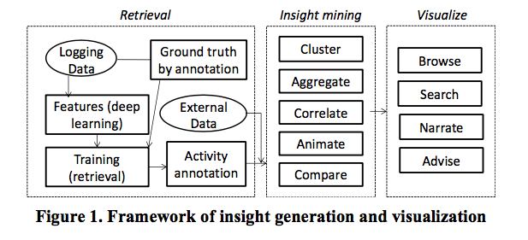
Method
First minute wise annotations of user’s activity are produced with respect to the the topics.
Second insights of user’s activity are generated that includes facts of activity occurrence , temporal and spatial patterns and associations among multiple activities.
Finally, we visualize the result in a themed diary in the form of a prototype mobile app that allows users to browse and search information, as well as being advised on healthy lifestyle.
Notes:
Image annotation is achieved by performing image understanding using deep learning followed by fusion of multi modality sensory data using retrieval model trained on ground truth data.
Multi modality sensory data : The study of how information from the different sensory modalities, such as sight, sound, touch, smell, self-motion and taste, may be integrated by the nervous system.

Slide 4
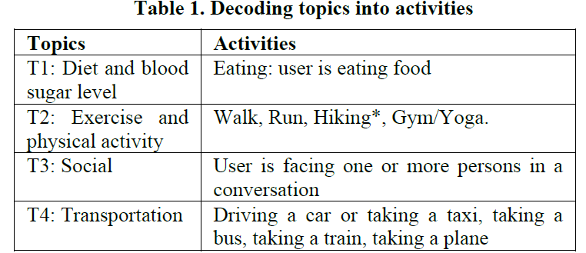
Retrieval - annotating user activities
Activity is the basic unit for describing user behaviors.
For any given topic, one or more activities can be inferred from the life log data.
If the topics are not related, then metadata (e.g. food log, health log, and GPS locations)and external data are used(e.g. food nutrition database).
Notes:
In this study, dietary information is extracted directly from the textual food log of u1. It is observed that the food log is not strictly structured. Multiple food items may appear in a single log item (e.g. “homemade bolognaise with wholewheat pasta and red wine cashew”); and different names may refer to the same type of food (“cerial”, “allbran cerial”, “all-bran”)

Slide 5
Insight Mining
There are few common strategies are applied for finding insights, which is further visualized in a few templates.
Aggregate : This is a process whereby one selects data points according to certain criteria and derives the statistics e.g. mean, variance, frequency etc.
Clustering : Group data points together based on specific distance measures.
Associate : Finds co relationship between different measurements. For e.g. how diet affects blood sugar level, what factors influence a user’s mood.
Animate : Animation is good for demonstrating the dynamics of data. That is, how things change over time. It can be combined with other information such as location and multimedia to provide richer viewing experience.
Compare: Compare the output from the above process.

Slide 6
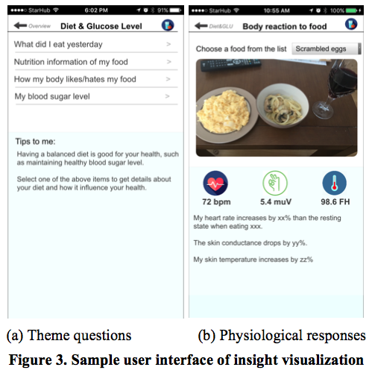
Mobile UI for lifelogging visualization
The output visualizations are integrated in a mobile app according to the selected topics.
Under each theme, there is a list of questions that is considered to be relevant to a user , as shown i the figure.

Slide 7
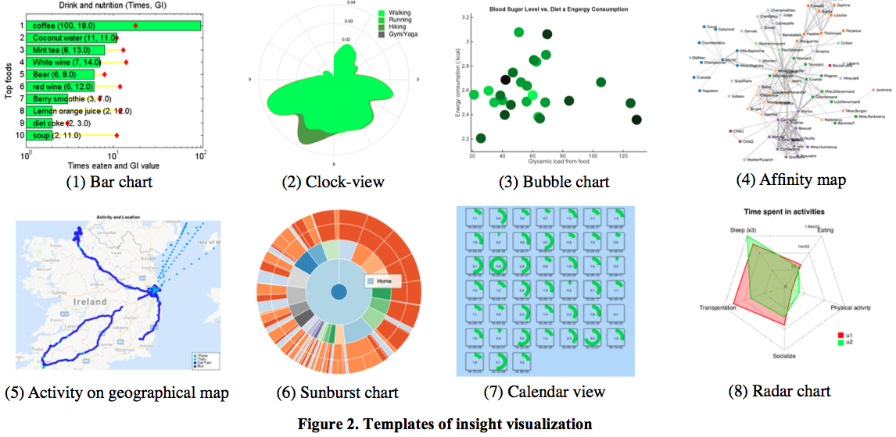
Templates for insight visualization
Notes:
(1) Bar chart shows rank-ordered frequency/occurrence.
(2) Clock-view of activity intensity shows the temporal
information of activities.
(3) Bubble chart illustrates association/correlation. If there are
two variables, the x-axis is the explanatory variable and y-axis
is the response variable. If there are three variables, both xand
y- axes capture the explanatory variables, the response
variable is shown as the size and/or color of the bubbles.
(4) Affinity map illustrates the clustering and relationship of
items according to certain distance metrics.
(5) Map is user to show geographical information. It can be
combined with time and multimedia for a more
comprehensive view.
(6) Sunburst view of integrated activity profile uses a series of
concentric rings to illustrate activities according to time and
location information. It also allows a user to view the lifelog
information at varying levels of granularity.
(7) Calendar view shows activity intensity over time.
(8) Radar chart compares two users along selected dimensions.

Slide 8
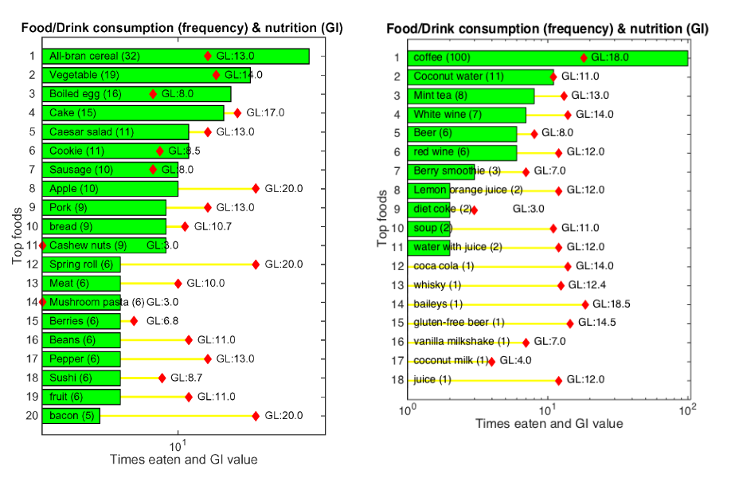
Diet and Blood Sugar Level
Illustrates the log of top foods and drinks consumed by one user.
Glycemic Load of food is a number that estimates how much the food will raise a person's blood glucose level after consuming it.
Glycemic Index is calculated by multiplying the grams of available carbohydrate in the food times the food's GI and then dividing by 100.
GL stands for Glycemic Load and GI stands for Glycemic Index
Notes:
Here the diet is shown by a bar chart which shows rank-ordered frequency/occurrence.
The GL value of each food/drink is shown as a red diamond marker.
User had a balanced diet , with a variety of food and varying levels of Glycemic Load.
We can infer that Users favorite food is Cereal and drink would be Coffee.

Slide 9
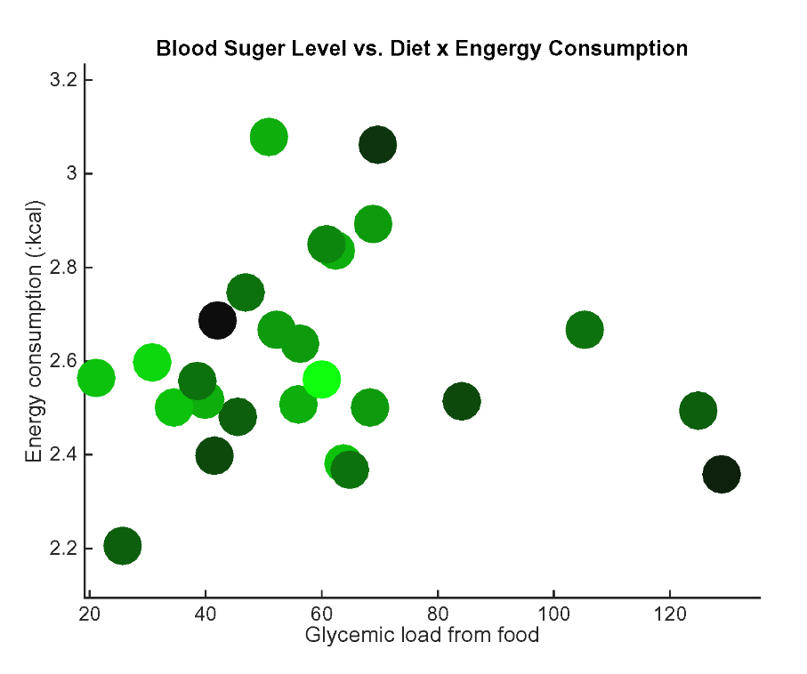
Diet and Blood Sugar Level(Continued)
Illustrates the possible factors that contribute to blood sugar level.
As Glycemic Load from food increases the circle becomes darker.
Food Intake is strongly correlated to Glucose Level inferred from correlation Analysis
Energy consumption and quality of sleep is weakly correlated with glucose level
Notes:
Here a Bubble chart is used for the possible factors that contribute to blood sugar level.
The glucose level is color-coded as circles: lighter green means lower glucose level and darker green means higher level.
Here the x-axis represents GL from food and y-axis represents energy consumption
The circles become darker as x increases

Slide 10
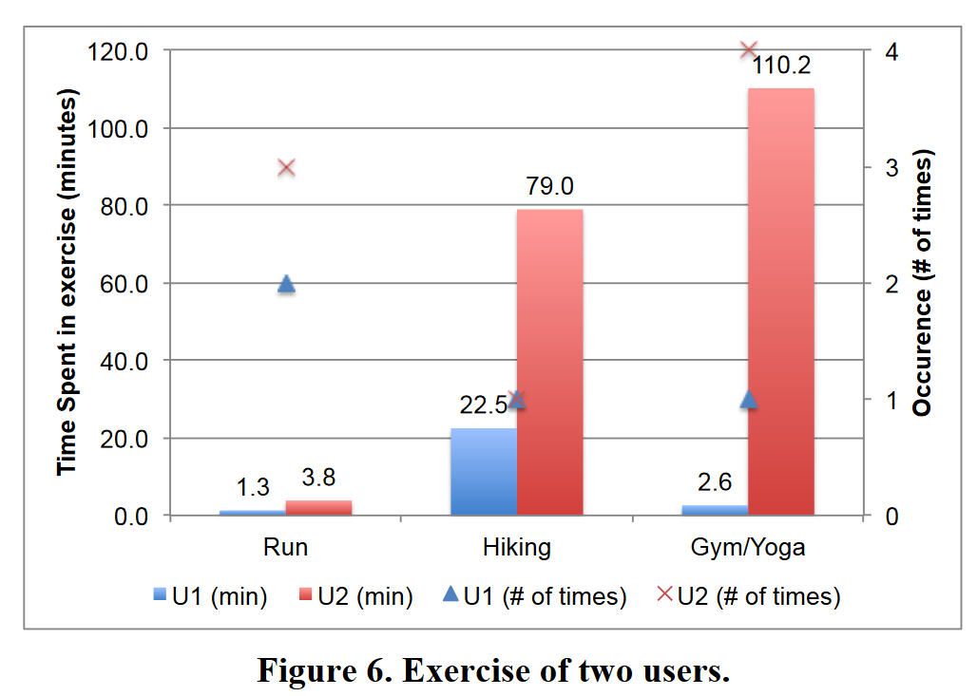
Exercise and physical activity
Modes of exercise - walking, running, hiking and gym/yoga.
Shows Exercise log of two Users.
Summarized as the number of occurrence and average duration of an occurrence
Notes:
Considering none of the users engaged in regular exercises other than normal walking.

Slide 11
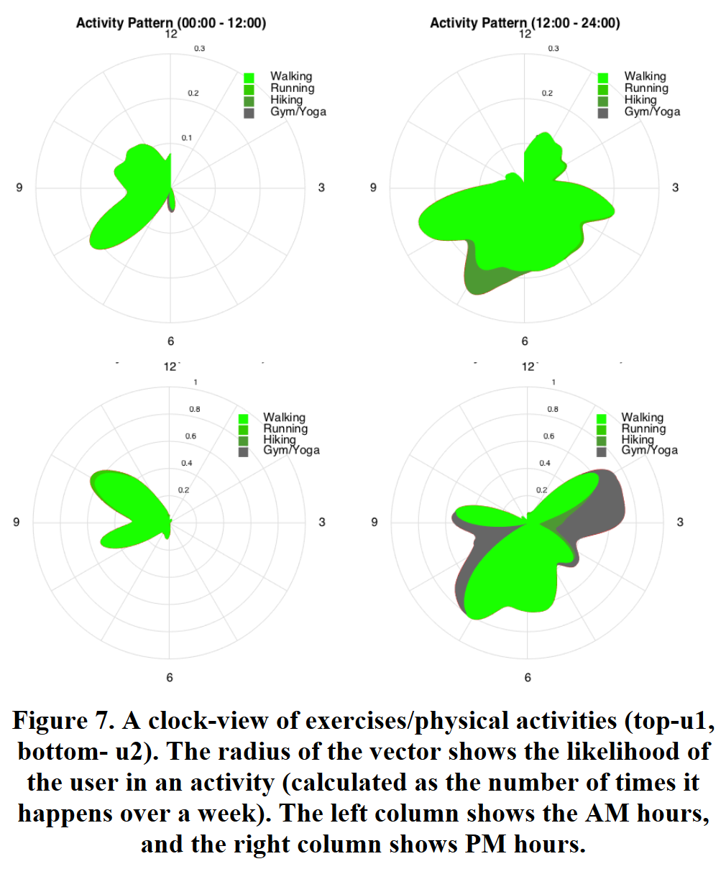
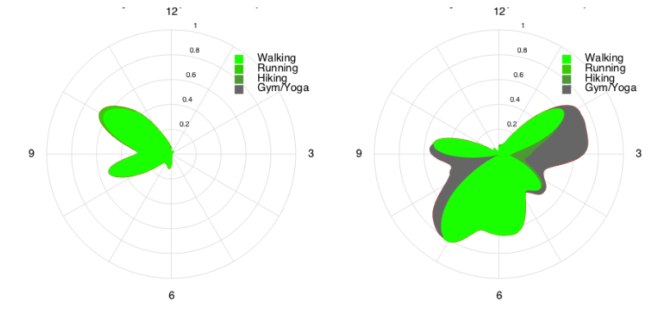
Exercise and physical activity(Continued)
USER 1
Shows the temporal pattern of users exercises.
The radius of the vector shows the likelihood of the user in an activity.
On comparing User 1 and User 2, User 2 spends more time exercising.
USER 2
Left column shows AM hours Right column shows PM hours
Notes:
Clock study the temporal pattern of users’ exercises.

Slide 12
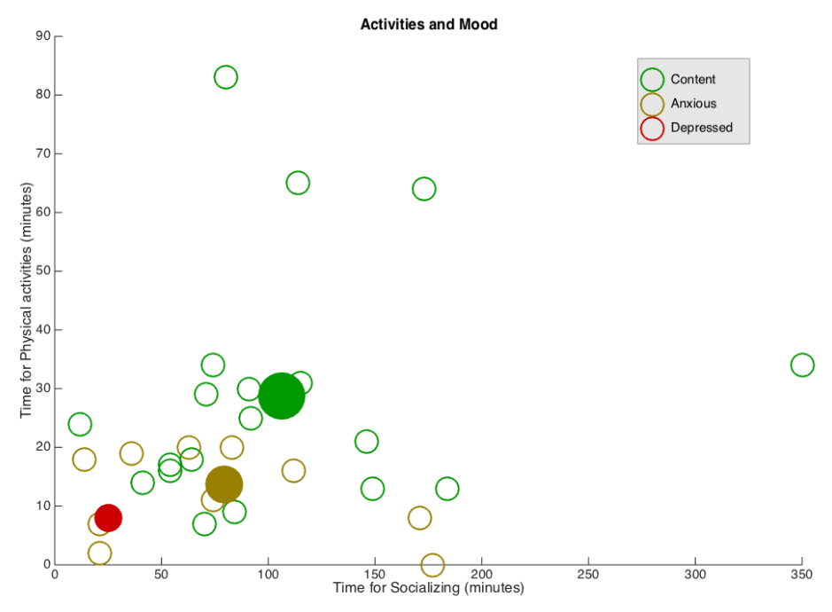
Social
Socializing is retrieved as moments when a user was interacting with one or a few persons who appeared in front of the user at a social distance.
Social Distance is estimated based on the size (in pixels) of detected persons in an image.
Illustrates if socializing activities contributed to the user’s emotional wellbeing.
Shows an obvious trend that both socializing and physical activities lead to better mood based on the sample considered.
Notes:
a bubble chart is drawn where the x-axis is the time spent in socializing in a day, y-axis is the time spent in exercising.
Moods are drawn as empty circles in different colors
Solid circles show the centroid of the variables, e.g. the solid green circle shows the average time spent in socialization and average time in physical exercise when the mood is “Content”. There is an obvious trend that both socializing and physical activities lead to better mood. It should be noted that the sample size is pretty small, only 31 days has mood log, and only one Depressed mood is reported. Therefore, the conclusion may not be strong.

Slide 13
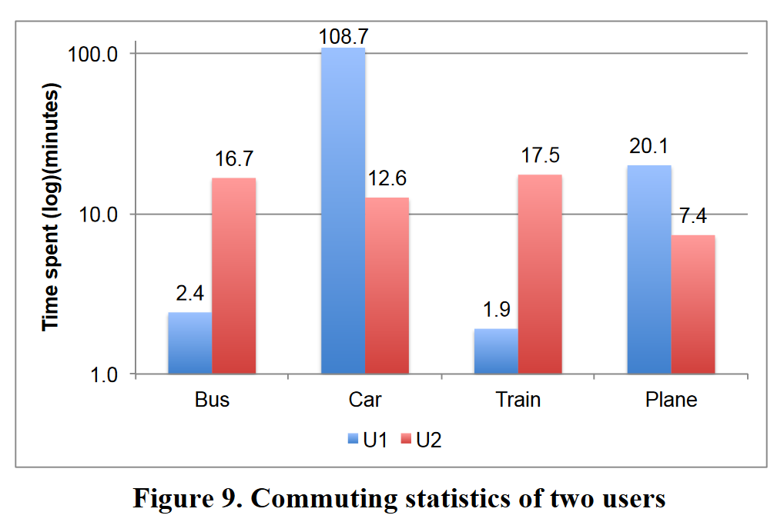
Where: location and movement
MODES OF COMMUTING
Shows commuting statistics of two Users in a day.
Here four modes of commuting is considered - Bus, car , Train and Plane.
Here User 1 has travelled more on car on that specific day, whereas User 2 has spent about 15 minutes on car, bus, train and plane on the same day.

Slide 14
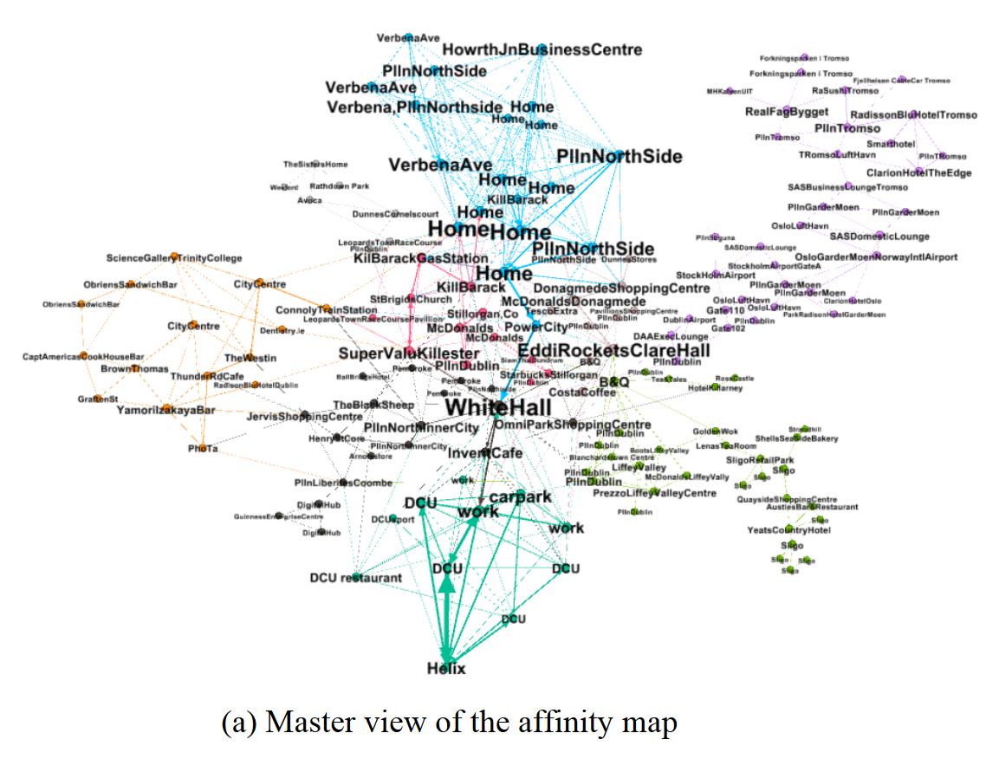
Where: location and movement (Continued)
AFFINITY MAP OF LOCATIONS
Built based on the connectivity of locations.
Two locations are connected, when they are in sequence and co-located within reasonable distance.
Clusters are generated where locations that are co-located in close geographical distance and temporal distance are clustered together.
Each node responds to unique GPS coordinate
thickness of the edge denotes the relative number of times a transition was seen.
Notes:
It is a directed graph, where each node corresponds to a unique GPS coordinate
The location tag is extracted from Google Map.

Slide 15
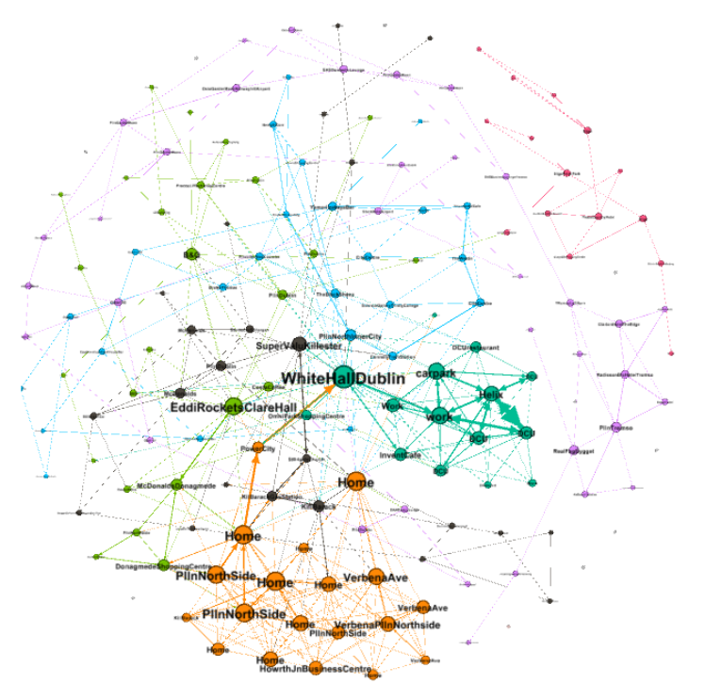
Where: location and movement (Continued)
AFFINITY MAP OF LOCATIONS (Continued)
Each edge corresponds to a transition from one tagged location to tagged location in sequence.
Thickness of the edge denotes the relative number of times a transition was seen.
Color of the nodes denotes the ‘modularity’ of the graph and nodes related to ‘Work’, ‘Home’,‘Shopping’, ‘Overseas travel’, etc. are clustered automatically.
Reveals some patterns that may be relevant to the user’s habits.
Affinity map showing walking as the commuting mode
Notes:
This graph can answer some questions at the such as,
‘What are the most frequent transitions made by the user?
‘Where does User1 shop before leaving overseas?’.
In addition, the graph reveals some patterns that may be relevant to the user’s habits.
For example, the graph suggests that user1 normally went from Home to Work directly (passing through ‘Power City’ and ‘WhiteHall’ on the way) but the same path was not always followed when returning home from work. The graph shows that u1 often took a path via ‘Super value Killester’ and ‘Kill Barack Gas station’) on the way back home.

Slide 16
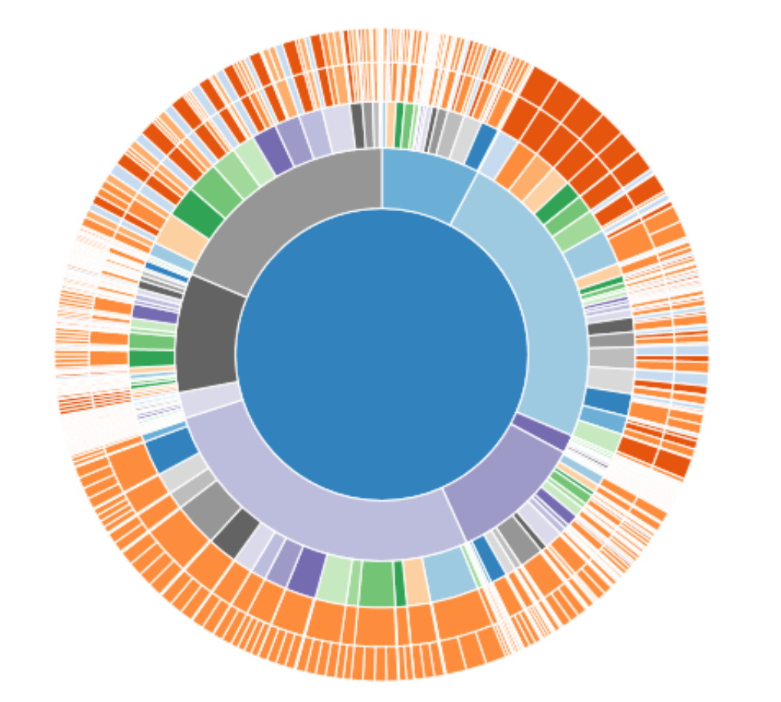
Where: location and movement (Continued)
SUNBURST CHART
Illustrates the activities performed in different location.
Provides an interactive way of slicing and dicing the data.
First concentric ring represents the location.
Second ring represents time in 1-hour intervals.
Third ring represents activities
Final ring represents sub-activities
Width of each slice in the final ring represents the count of a particular tuple of location, time , activity and sub activity.
Sunburst view of spatio-temporal distribution of activities
Notes:
First concentric ring represents one of these locations - Home, Work,Café/restaurant, Shop, Other Town,Overseas, Other-known, Unknown

Slide 17
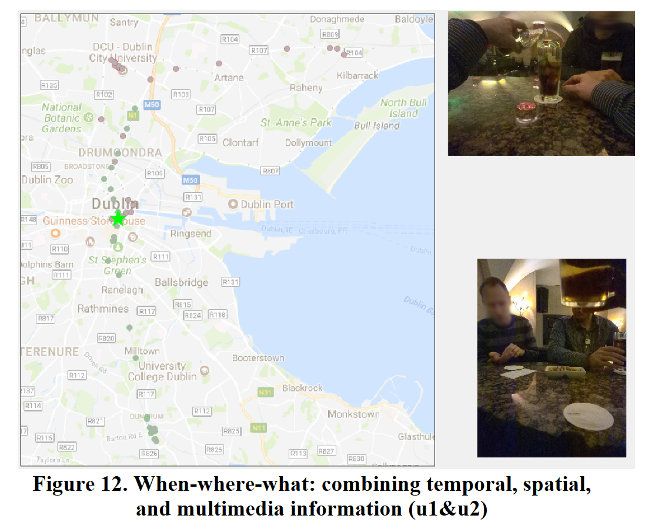
Where: location and movement (Continued)
CO-LOCATION OF TWO PERSONS
Co-location of two persons can be visualized in an animation
Considering GPS information and merging the temporal information and multimedia.
Notes:
By setting a Threshold distance of 30 meters, it is found that two users meet each other at dinnertime in downtown Dublin on a specific day.
snapshot of the UI that marks the location of two users on that day, together with a slide show of lifelog photos of both users.

Slide 18
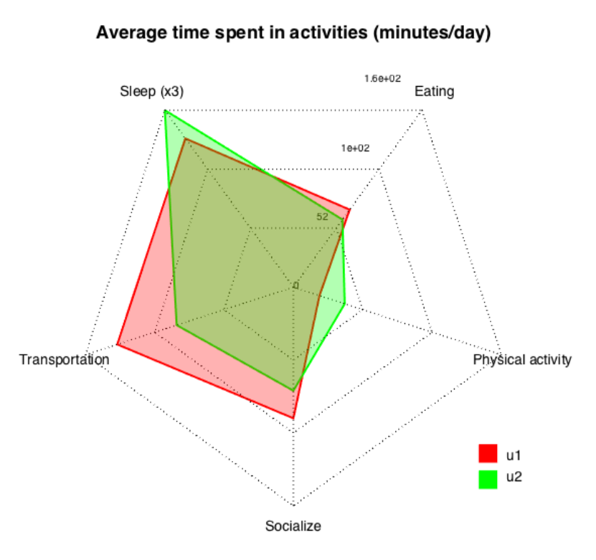
Comparison
The author uses a Radar chart to compare the time spent on activities like Eating, Sleep, Physical activity,Transportation and Socializing of two different users.
User 1 spent more time in commuting, eating and socializing, whereas User 2 has more physical activity and enjoyed more sleep.

Slide 19
THANK YOU

